Slide 1
Lecture 16- Lean Thinking
Dr Paul Jarvis
J303
paul.jarvis@southwales.ac.uk

Slide 2
Learn
What are Type 1 and Type 2 Muda?
What is flow?
What is the Law of Velocity?

Slide 3
Lean Thinking
Maximise the amount of work not done (avoid unnecessary work)
Work smarter, not harder
https://www.youtube.com/watch?v=PXZPMAXniTs
Based mostly on work by Kiichiro Toyoda, Taiichi Ohno, and others at Toyota in Japan.
Originally codified and published in Womack, J.P., Jones, D.T. and Roos, D. (1990) The Machine That Changed the World. Free Press.
Further developed in Womack, J.P., and Jones, D.T. (1996) Lean Thinking: Banish Waste and Create Wealth in Your Corporation. 1ed. New York: Simon & Schuster.
Key concepts are simplicity, speed, focus, quality, and an emphasis on customers’ needs

Slide 4
Five Laws of Lean (0-4)
0. The Law of the Market
1. The Law of Flexibility
2. The Law of Focus
3. The Law of Velocity
4. The Law of Complexity and Cost

Slide 5
Value
We use this term in ITSM a lot. Who determines whether something is of value?
The Customer
Customers want value. They want something:
Of the desired quality
At the right time and place
At an appropriate price
A business can do things that produce short-term benefits:
Raise prices
Cut costs (without passing on savings to customers)
Use effort to make internal changes that make life easier (without helping customers)
None of these benefit customers, who will go elsewhere if they aren’t getting value

Slide 6
Muda
A Japanese word meaning futility, uselessness, and wastefulness
In lean thinking, muda activities absorb resources but add no value. Examples:
Processing steps that aren’t absolutely necessary.
Mistakes that require rectification.
Producing goods that no-one wants, so inventories pile up.
Adding features that no-one uses, wasting our effort.
Providing services that don’t meet the needs of customers
Type 1 Muda
Activities that create no value but seem to be unavoidable with current technologies or production assets
Type 2 Muda
Activities that create no value and are immediately avoidable

Slide 7
Business Relationship Managers
In ITIL, what do BRMs do?
Among other things, they find out what the customer really wants, to make sure we are fulfilling their needs.
Not telling them what we think they need
Some businesses find it hard to specify value and focus on what is convenient for them, not the customer.
For example, creating ‘efficiency’ by producing large batches at a time
Imagine a call to your mobile provider:
“If you pay just £3 extra per month then I can add our new ‘Track My Number of Voicemails’ App. It is usually £4 per month! You’d find it really useful! It would help me hit my sales target and we spent a long time developing this app.”
This doesn’t add value for the customer
Type 1 Muda
Unavoidable with current technologies
Type 2 Muda
Immediately avoidable
Type 1 or Type 2 Muda?
Type 2

Slide 8
0. The zeroth law: the Law of the Market
“Customer Critical To Quality defines quality and is the highest priority for improvement, followed by ROI (Return On Investment) and net present value.”
(Stern, 2017)
We must define value properly, so that our focus is in the right place, ie. customers are the highest priority.
All other principles are built upon this
Notes:
Note: In PRINCE2, AgilePM, DSDM and ITIL, the distinction between the Business, Customers and Users is clear. In Lean Thinking (and Agile?) the distinction is not so clear.

Slide 9
Mobile phones
How do customers think about screen size in terms of value? How has this changed over time?
We can work on improving things as much as we want. But are we working on the right things? Do they add value?

Slide 10
Value Stream
A value stream maps out the activities taken to deliver the product or service. ‘Items’ flow through the stream of tasks to completion
Items flow through the stream
Task 1
Task 2
Task 3
Task 4
3 types of tasks (Womack and Jones, 2003):
Problem-solving tasks: eg. Designing something
Information management tasks: eg. Taking an order from a customer
Physical transformation tasks: eg. Assembling components
‘Items’ might be physical objects.
Example: Materials in manufacturing (putting together a phone)
‘Items’ might not be physical objects.
Example: Customer needs being fulfilled by receiving a service (assigning a customer to a phone contract)

Slide 11
Value Stream: Example
3 types of tasks (Womack and Jones, 2003):
Problem-solving tasks: eg. Designing something
Information management tasks: eg. Taking an order from a customer
Physical transformation tasks: eg. Assembling components
Items flow through the stream
Task 1
Task 2
Task 3
Task 4
Customer orders new TV from a website
Work out when it can be delivered, which van, optimal route
Inform customer of delivery window
Put it on the van, deliver it
Type
Type
Type
Type
2
1
2
3

Slide 12
1. The next law: the Law of Flexibility
“The velocity of any process is proportional to the flexibility of the process.”
The more the process is receptive and flexible to adopt changes, the easier it is to optimise overall performance.
If we stick rigidly to our old ways, we can’t improve

Slide 13
Value Achieved?
Value-Added Tasks
Activities that create value
Muda
No value
Items flow through the stream
Task 1
Task 2
Task 3
Task 4
Customer orders new TV from a website
Work out when it can be delivered, which van, optimal route
Inform customer of delivery window
Put it on the van, deliver it
Value?
Value?
Value?
Value?
Yes
No
Yes
Yes

Slide 14
Muda Tasks
Task 2
Work out when it can be delivered, which van, optimal route
Finding the optimal route for a van with lots of items to deliver doesn’t create value for the customer. Can we avoid it or not, given our resources?
Is it Type 1 or Type 2?
Ideally we should map the entire supply chain.
Our goal is to minimise avoidable activities.
Do this through Value Stream Analysis

Slide 15
Value Stream Analysis
Value Stream Analysis is a planning tool for optimising the results. We examine our current state Value Stream Mapping (VSM), apply Lean Thinking principles and create an optimised future state VSM
Current State VSM
Task 1
Task 2
Task 3
Task 4
Apply Lean Thinking principles
Future State VSM
Task 1
Task 2b (changed)
Task 3

Slide 16
Value Stream Analysis Steps
Example muda (Minitab, 2010):
overproduction, excess inventory, uneven flow;
unnecessary motion, transportation;
over-processing;
defects;
inefficient use of human intellect.
Specify value from customer perspective.
Identify the value stream for each product family.
Eliminate Type 2 Muda.
Make the value stream flow smoothly.
Replace supplier ‘push’ with customer ‘pull’.
Manage toward perfection, reducing amount of time and information needed to serve the customer
In a nutshell…Specify value from customer perspective.
Identify the value stream for each product family.
Eliminate Type 2 Muda.
Make the value stream flow smoothly.
Replace supplier ‘push’ with customer ‘pull’.
Manage toward perfection, reducing amount of time and information needed to serve the customer
More about flow soon

Slide 17
2. The second law: the Law of Focus
“20% of the activities in a process cause 80% of the delay.”
The main causes of delay in the overall process usually come from a small proportion of the activities.
It only takes a few areas to be improved to bring about a large impact

Slide 18
Flow
‘Flow’ means work that is conducted smoothly and efficiently.
Flow pulled by customers rather than pushed by suppliers:
The customer decides how much they want and when
[ITIL: demand pulls capacity, not the other way around]
Low wait times; even flow, without peaks and troughs (mura)
There are ways of working that can hinder flow:
Batches
‘Just In Case’
Errors
Departments

Slide 19
Barriers to flow 1: Batches
Batches can appear to be efficient in isolation
Individual process efficiency increases. Workers and equipment do a lot of the same kind of work without needing to make changes
Produce components (continuous)
Assemble components (batch of 100)
Finish off the items (continuous)
Store up enough components for the batch process
100 assembled items piled up from the batch process
Overall system efficiency decreases. Delays just before and just after each batch process

Slide 20
Batch sizes
Large batches prevent us from customising individual items
Can you think of an example where modern technology makes it easy to produce a batch size of one?
Books: previously large printing runs needed; many books unsold and wasted. Now generate one electronic copy when needed
Printing a large batch is muda:
Used to be Type ?
Now, Type ?
Example: cars.
Each car needs a different colour, seat cover, radio, etc. It’s very hard to identify the right batch size for each specification
1
2
Agile software development uses development cycles (‘sprints’) that involve regular testing of added features (a batch of 1 feature at a time).
Traditionally, an entire system was developed before testing (a batch of lots of features that took a long time)

Slide 21
Barriers to flow 2: Just In Case
We could produce items ahead of time, then we can use them instantly, just in case we need them later
Why does this hinder flow?
Lots of Work In Progress (WIP) ties up capital, components, storage space, wastes time.
We might end up not needing them:
Items become obsolete, items get damaged
Alternative:
Just In Time.
If components arrive exactly when you want them, you never need to store anything
In software development, we could waste effort developing features customers don’t want (“just in case someone does want it”). Not providing value

Slide 22
Barriers to flow 3: Errors
Errors cause several problems:
Work is wasted.
Further work required to correct errors
Downstream processes are delayed
Reworked items are often of a lower standard, are less reliable, etc
Delayed orders lead to dissatisfaction.
Which of these disrupt flow?
Lean Thinking:
Poka yoke: in built preventative measures.
Example: entering a date into a system-select from a calendar rather than type in

Slide 23
Barriers to flow 4: Departments
Traditionally, group people who do similar tasks
Sales & marketing
Production
Accounting
Product A
Product B
Product C
Product A
Product B
Product C
Product A
Product B
Product C
Work might become disjointed, lack of communication, delays
Alternatively, group people who work on the same product or service
Product A
Record sale
Order goods
Manu- facture
Asse- mble
Disp- atch
Invoice
Chase paymnt
Cash

Slide 24
3. The third law: the Law of Velocity
“The velocity of any process is inversely proportional to the amount of ‘work in progress’ (WIP). This is also called Little’s Law.”
The more work in progress (unfinished tasks), the slower the overall process.
Batches create a lot of WIP.
‘Just In Case’ creates a lot of WIP.
Errors create a lot of WIP.
Departments create a lot of WIP.

Slide 25
4. The fourth and last law: The Law of Complexity and Cost
“The complexity of the service or product offering adds more non-value, costs, and WIP than either poor quality (low sigma) or slow speed (unlean) process problems.”
We should aim to develop the minimum viable solution.
Do what needs to be done, no more

Slide 26
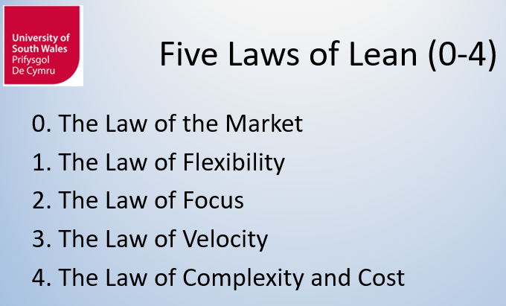
Conclusions
‘Lean’ emphasises producing the minimum viable solution:
simplest, quickest, cheapest yet still effective;
avoid tying up resources unnecessarily;
maximising work not done.
Lean Thinking is applicable to software development.
We will look at how it relates to Agile in particular next time

Slide 27
Five laws
Provide value from the customer perspective
Being receptive to changes allows us to optimise performance
A few small changes can have a big overall impact
Work only on what we need to, producing the minimum viable solution
Minimising work in progress (unfinished tasks) gets to the goal quicker

Slide 28
Summary
What are Type 1 and Type 2 Muda?
What is flow?
What is the Law of Velocity?

Slide 29
References
LucidChart (2016) All About Value Stream Mapping. www.lucidchart.com/pages/value-stream-mapping (accessed 25 Nov 16)
MiniTab (2010) Map the Value Stream. https://www.minitab.com/uploadedFiles/Documents/sample-materials/TrainingSampleValueStreamQC3.pdf (accessed 25 Nov 16)
Stern, T.V. (2017) Lean and Agile Project Management. CRC Press Taylor and Francis.
Washington (nd) Value Stream Mapping. University of Washington. http://courses.washington.edu/ie337/Value_Stream_Mapping.pdf (accessed 5 Jan 17)
Womack, J.P., and Jones, D.T. (2003) Lean Thinking: Banish Waste and Create Wealth in Your Corporation. 2ed. New York: Simon & Schuster.

Slide 30
Annex Value stream mapping (1)
A value stream map illustrates the flow of materials and information as the product or service moves through the process.
Use a value stream map to identify one or more of the following types of waste:
overproduction, excess inventory, uneven flow;
unnecessary motion, transportation;
over-processing;
defects;
inefficient use of human intellect.
(Minitab, 2010)

Slide 31
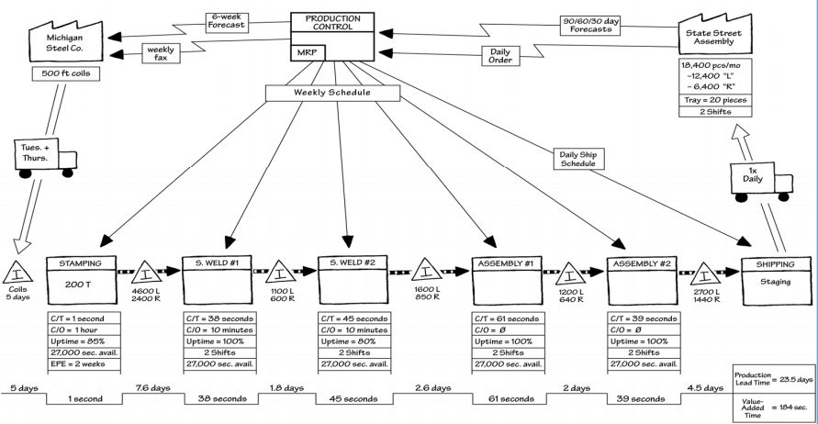
Annex Value stream mapping (2)
Example VSM of a manufacturing system that has extensive WIP and delays.
(Washington, nd)

Slide 32
Annex Tips for value stream mapping (1)
Experience directly. You (or your team) should follow the whole value stream yourself. Don’t rely on impressions, assumptions, or conversations about how things “usually” happen. If it’s a physical thing, walk it, use a stopwatch to time various steps, and experience it all as directly as possible. At least one team member needs to walk the whole stream. If you rely on subteams to walk different portions, and nobody walks the whole thing, you will miss an essential perspective to VSM.
(LucidChart, 2016)

Slide 33
Annex Tips for value stream mapping (2)
Sketch an initial VSM by hand. Start by sketching in pencil as you document the steps. Later you can use chart-drawing software to communicate and collaborate better and map out a future/ideal state.
Do initial walk-through. You might start with a quick walk to experience it at an overview level, and then do it again in more detail.
(LucidChart, 2016)

Slide 34
Annex Tips for value stream mapping (3)
Try doing it in reverse, from end product or service to its origins. Various items could become more clear and meaningful with that perspective. Many veteran VSM practitioners do it this way.
Keep asking why. In Lean Six Sigma, it’s sometimes called the Five Whys. The idea is to simply ask why something is done as it is. To the response, another why is asked. This continues until you drill down to the ultimate basis for the action.
(LucidChart, 2016)

